Slide 1
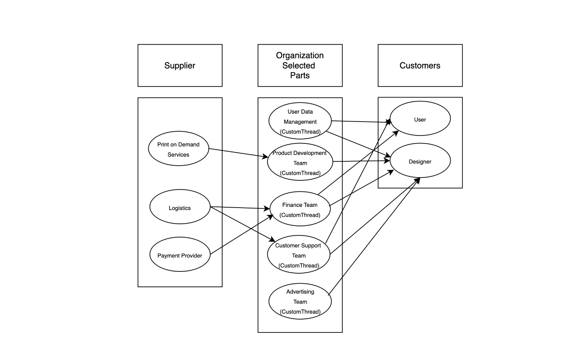
Custom Threads - BRM Diagram

Slide 2
Custom Threads: SIPOC Diagram
S
I
P
O
C
Supplier
Inputs
Process
Outputs
Customers
Print on Demand Service
Logistics
Payment Provider
Customer T-shirt
Design
Design artwork
Uploads
Payments
Design
Custom T-shirts
Delivered
Commission
payments
Order fulfillment
Report
Order Placement
Individuals
Designers
Payment Processing
Printing
Shipping
Delivery

Slide 3
User Roles by Business Group
External Users (Customers)
Users (Om Patel)
Designer User (Abhishek Sharma)
Internal Users
Team Members gather business requirements for their assigned business stakeholders.
Business Group | User Roles | Team Member Name (Bus. Group Proxy)
Product Developement team | Product Designer | Jeel Dhola
Finance Team | Financial Analyst | Shiv Vyas
Customer Support Team | Customer Support Representative | Manav Joshi
Advertising Team | Marketing Analyst | Chandan Yadav
User Management Team | User Access Manager | Dunstan D’Souza

